Slide 1
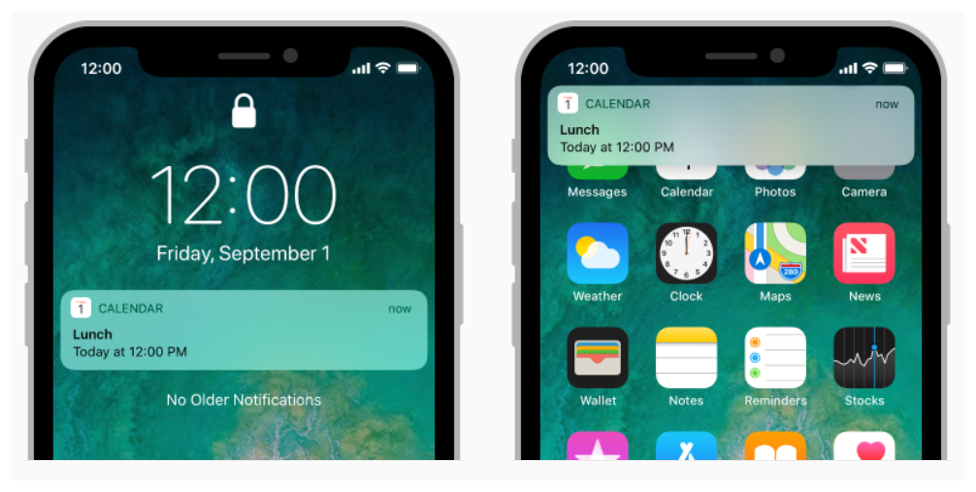
Unit-V
Advance Topics
Mobile Application Development Technology
Presented By: Binod Bhandari Mobile Technology

Slide 2
Course Contents
User Notification
Create and send Notification
Broadcast Receivers class
Creating a Broadcast Receiver
Registering Broadcast Receiver
Broadcasting custom intents
System Generated Events
Presented By: Binod Bhandari Mobile Technology

Slide 3
Course Contents
Manifest File
System Generated Events
Threads, AsyncTask and Handlers
Alarms and its types
Networking
Checking Network Connection
Performing Network Operations
Presented By: Binod Bhandari Mobile Technology

Slide 4
User Notification
A notification is a message we can display to the user outside of our application’s normal UI. When we tell the system to issue a notification, it first appears as an icon in the notification area.
Presented By: Binod Bhandari Mobile Technology

Slide 5
Create and Send Notification
Create Notification Builder
Setting Notification properties
Attach Actions
Issue the notification
Presented By: Binod Bhandari Mobile Technology

Slide 6
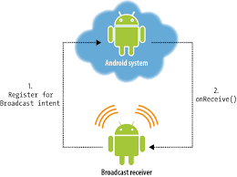
Broadcast Receivers Class
Presented By: Binod Bhandari Mobile Technology

Slide 7
Creating a Broadcast Receiver
A broadcast receiver is implemented as a subclass of BroadcastReceiver class and overriding the onReceive() method where each message is received as an Intent object parameter.
Presented By: Binod Bhandari Mobile Technology

Slide 8
public class MyReceiver extends BroadcastReceiver{
@override
public void onReceive(Context context, Intent intent){
Toast.makeText(context, “IntentDetected”, Toast.LENGTH_LONG).show();
}
Presented By: Binod Bhandari Mobile Technology

Slide 9
Registering Broadcast Receiver
An application listers for specific broadcast intents by registering a broadcast receiver in Android Manifest.xml file
<intent-filter>
<action android:name=“android.intent.action.BOOT_COMPLETES”></action>
</intent-filter>
Presented By: Binod Bhandari Mobile Technology

Slide 10
Broadcasting Custom Intents
If we use the sendStickyBroadcast(Intent) method, the Intent is sticky, meaning the Intent we are sending stays around after the broadcast is complete.
Public void broadcastIntent(View view){
Intent intent=new Intent();
Intent.setAction(“myintent.CUSTOM_INTENT”);
sendBroadcast(intent);
}
Presented By: Binod Bhandari Mobile Technology

Slide 11
Manifest File
The Manifest file contains information of our package, including components of the application such as activities, services, broadcast receivers, content providers etc.
It is responsible to protect the application to access any protected parts by providing the permissions.
It is also declares the android api that the application is going to use.
Presented By: Binod Bhandari Mobile Technology

Slide 12
It lists the instrumentation classes. The instrumentation classes provides profiling and other information. These information are removed just before the application is published etc.
This is the required xml file for all the android application and located inside the root directory.
<action android:name=“myintent.CUSTOM_INTENT”>
Presented By: Binod Bhandari Mobile Technology

Slide 13
System Generated Events
BATTERY_CHANGED
BATTERY_LOW
BATTERY_OKAY
BOOT_COMPLETED
BUG_REPORT
CALL
DATE_CHANGED
REBOOT
Presented By: Binod Bhandari Mobile Technology

Slide 14
Threads
A thread is a thread of execution in a program. The java virtual machine allows an application to have multiple threads of execution running concurrently.
Every thread has a priority. Threads with higher priority are executed in preference to threads with lower priority. Each thread may or may not also be marked as a daemon.
When code running in some thread creates a new Thread object, the new thread has its priority initially set equal to the priority of the creating thread and is a daemon thread if and only if the creating thread is a daemon.

Slide 15
AsyncTask
Async Task’s Generic Types
Param
Progress
Result
The 4 steps
onPreExecute()
doInBackground(Params…);
onProgressUpdate(Progress…);
onPostExecute(Result)…;

Slide 16

Presented By: Binod Bhandari Mobile Technology

